Slide 1
Data Exploration

Slide 2
1.Steps of Data Exploration and Preparation
Below are the steps involved to understand, clean and prepare your data for building your predictive model:
1.Variable Identification
2.Univariate Analysis
3.Bi-variate Analysis
4.Missing values treatment
5.Outlier treatment
6.Variable transformation
7.Variable creation
Finally, we will need to iterate over steps 4 – 7 multiple times before we come up with our refined model.

Slide 3
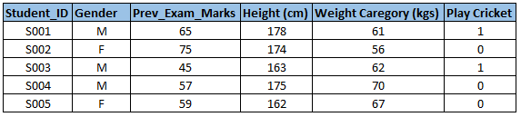
Variable Identification
First, identify Predictor (Input) and Target (output) variables. Next, identify the data type and category of the variables.
Example:- Suppose, we want to predict, whether the students will play cricket or not (refer below data set). Here you need to identify predictor variables, target variable, data type of variables and category of variables.

Slide 4
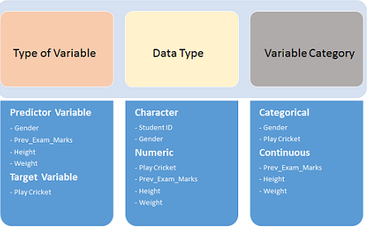
Below, the variables have been defined in different category:

Slide 5
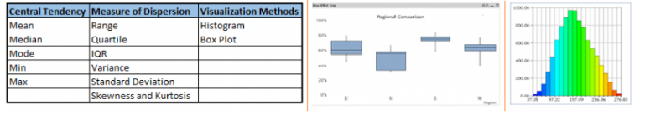
Univariate Analysis
we explore variables one by one. Method to perform uni-variate analysis will depend on whether the variable type is categorical or continuous. Let’s look at these methods and statistical measures for categorical and continuous variables individually:
Continuous Variables:- In case of continuous variables, we need to understand the central tendency and spread of the variable. These are measured using various statistical metrics visualization methods as shown below:

Slide 6
Categorical Variables:- For categorical variables, we’ll use frequency table to understand distribution of each category. We can also read as percentage of values under each category. It can be be measured using two metrics, Count and Count% against each category. Bar chart can be used as visualization.

Slide 7
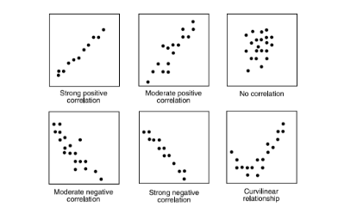
Bi-variate Analysis
Continuous & Continuous: While doing bi-variate analysis between two continuous variables, we should look at scatter plot. It is a nifty way to find out the relationship between two variables. The pattern of scatter plot indicates the relationship between variables. The relationship can be linear or non-linear.

Slide 8
Categorical & Continuous: While exploring relation between categorical and continuous variables, we can draw box plots for each level of categorical variables. If levels are small in number, it will not show the statistical significance. To look at the statistical significance we can perform Z-test, T-test or ANOVA.
Z-Test/ T-Test:- Either test assess whether mean of two groups are statistically different from each other or not ztest formula If the probability of Z is small then the difference of two averages is more significant. The T-test is very similar to Z-test but it is used when number of observation for both categories is less than 30.

Slide 9
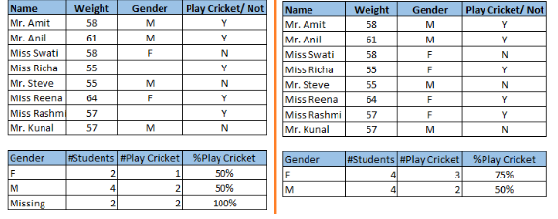
Missing values treatment
Missing data in the training data set can reduce the power / fit of a model or can lead to a biased model because we have not analyzed the behavior and relationship with other variables correctly. It can lead to wrong prediction or classification.
In the left scenario, we have not treated missing values. The inference from this data set is that the chances of playing cricket by males is higher than females. On the other hand, if you look at the second table, which shows data after treatment of missing values (based on gender), we can see that females have higher chances of playing cricket compared to males.

Slide 10
Why my data has missing values?
let’s identify the reasons for occurrence of these missing values. They may occur at two stages:
Data Extraction: It is possible that there are problems with extraction process. In such cases, we should double-check for correct data with data guardians. Some hashing procedures can also be used to make sure data extraction is correct. Errors at data extraction stage are typically easy to find and can be corrected easily as well.
Data collection: These errors occur at time of data collection and are harder to correct. They can be categorized in four types

Slide 11
Data collection
Missing completely at random: This is a case when the probability of missing variable is same for all observations. For example: respondents of data collection process decide that they will declare their earning after tossing a fair coin. If an head occurs, respondent declares his / her earnings & vice versa. Here each observation has equal chance of missing value.
Missing at random: This is a case when variable is missing at random and missing ratio varies for different values / level of other input variables. For example: We are collecting data for age and female has higher missing value compare to male

Slide 12
Missing that depends on unobserved predictors: This is a case when the missing values are not random and are related to the unobserved input variable. For example: In a medical study, if a particular diagnostic causes discomfort, then there is higher chance of drop out from the study. This missing value is not at random unless we have included “discomfort” as an input variable for all patients.
Missing that depends on the missing value itself: This is a case when the probability of missing value is directly correlated with missing value itself. For example: People with higher or lower income are likely to provide non-response to their earning.

Slide 13
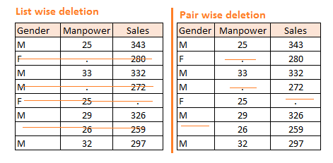
Which are the methods to treat missing values ?
Deletion: It is of two types: List Wise Deletion and Pair Wise Deletion.
List wise deletion: we delete observations where any of the variable is missing. Simplicity is one of the major advantage of this method, but this method reduces the power of model because it reduces the sample size.
Pair wise deletion: we perform analysis with all cases in which the variables of interest are present. Advantage of this method is, it keeps as many cases available for analysis. One of the disadvantage of this method, it uses different sample size for different variables.

Slide 14
Mean/ Mode/ Median Imputation:
Generalized Imputation: In this case, we calculate the mean or median for all non missing values of that variable then replace missing value with mean or median. Like in above table, variable “Manpower” is missing so we take average of all non missing values of “Manpower” (28.33) and then replace missing value with it.
Similar case Imputation: In this case, we calculate average for gender “Male” (29.75) and “Female” (25) individually of non missing values then replace the missing value based on gender. For “Male“, we will replace missing values of manpower with 29.75 and for “Female” with 25.

Slide 15
Prediction Model:
Prediction model is one of the sophisticated method for handling missing data. In this case, we divide our data set into two sets:
1.One set with no missing values for the variable
2.With missing values.
First data set become training data set of the model while second data set with missing values is test data set and variable with missing values is treated as target variable.
Next, we create a model to predict target variable based on other attributes of the training data set and populate missing values of test data set.
We can use regression, ANOVA, Logistic regression and various modeling technique to perform this.

Slide 16
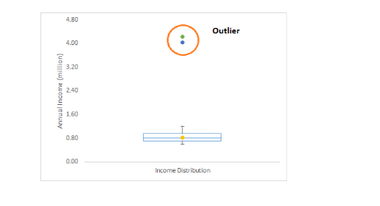
Techniques of Outlier Detection and Treatment
What is an Outlier?
Outlier is an observation that appears far away and diverges from an overall pattern in a sample.
we do customer profiling and find out that the average annual income of customers is $0.8 million. But, there are two customers having annual income of $4 and $4.2 million. These two customers annual income is much higher than rest of the population. These two observations will be seen as Outliers.

Slide 17
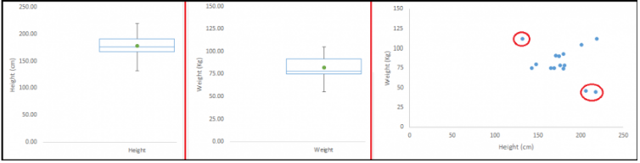
What are the types of Outliers?
Outlier can be of two types:
Univariate and Multivariate.
Let us say we are understanding the relationship between height and weight. Below, we have univariate and bivariate distribution for Height, Weight. Take a look at the box plot. We do not have any outlier (above and below 1.5*IQR, most common method). Now look at the scatter plot. Here, we have two values below and one above the average in a specific segment of weight and height.

Slide 18
What causes Outliers?
Let’s understand various types of outliers in more detail:
Data Entry Errors:- Human errors such as errors caused during data collection, recording, or entry can cause outliers in data
Measurement Error:-It is the most common source of outliers. This is caused when the measurement instrument used turns out to be faulty.
Data Processing Error: Whenever we perform data mining, we extract data from multiple sources. It is possible that some manipulation or extraction errors may lead to outliers in the dataset.
Natural Outlier: When an outlier is not artificial (due to error), it is a natural outlier. For instance: that the performance of top 50 financial advisors was far higher than rest of the population. Surprisingly, it was not due to any error. Hence, whenever we perform any data mining activity with advisors, we used to treat this segment separately.

Slide 19
What is the impact of Outliers on a dataset?
Outliers can drastically change the results of the data analysis and statistical modeling.
There are numerous un favourable impacts of outliers in the data set:
It increases the error variance and reduces the power of statistical tests
If the outliers are non-randomly distributed, they can decrease normality
They can bias or influence estimates that may be of substantive interest
They can also impact the basic assumption of Regression, ANOVA and other statistical model assumptions.

Slide 20
How to detect Outliers?
Most commonly used method to detect outliers is visualization. We use various visualization methods, like Box-plot, Histogram, Scatter Plot Some analysts also various thumb rules to detect outliers.
Some of them are:
Any value, which is beyond the range of -1.5 x IQR to 1.5 x IQR
Use capping methods. Any value which out of range of 5th and 95th percentile can be considered as outlier
Data points, three or more standard deviation away from mean are considered outlier
Outlier detection is merely a special case of the examination of data for influential data points and it also depends on the business understanding

Slide 21
How to remove Outliers?
Deleting observations: We delete outlier values if it is due to data entry error, data processing error or outlier observations are very small in numbers. We can also use trimming at both ends to remove outliers.
Transforming and binning values: Transforming variables can also eliminate outliers. Natural log of a value reduces the variation caused by extreme values. Binning is also a form of variable transformation. Decision Tree algorithm allows to deal with outliers well due to binning of variable. We can also use the process of assigning weights to different observations.

Slide 22
Imputing: Like imputation of missing values, we can also impute outliers. We can use mean, median, mode imputation methods. Before imputing values, we should analyse if it is natural outlier or artificial. If it is artificial, we can go with imputing values. We can also use statistical model to predict values of outlier observation and after that we can impute it with predicted values.
Treat separately: If there are significant number of outliers, we should treat them separately in the statistical model. One of the approach is to treat both groups as two different groups and build individual model for both groups and then combine the output.

Slide 23
The Art of Feature Engineering
What is Feature Engineering?
Feature engineering is the science (and art) of extracting more information from existing data.
What is the process of Feature Engineering ?
You perform feature engineering once you have completed the first 5 steps in data exploration – Variable Identification, Univariate, Bivariate Analysis, Missing Values Imputation and Outliers Treatment.
Feature engineering itself can be divided in 2 steps:
Variable transformation.
Variable / Feature creation.

